Slide 1
AI-Enhanced Rice Variety Classification
INFSCI 2240 AI
Team Members: Chengzhuo Xiong (CHX53)
Yuxuan Feng (YUF47)
Yutong Tang (YUT89)

Slide 2
Part 1 Presentation

Slide 3
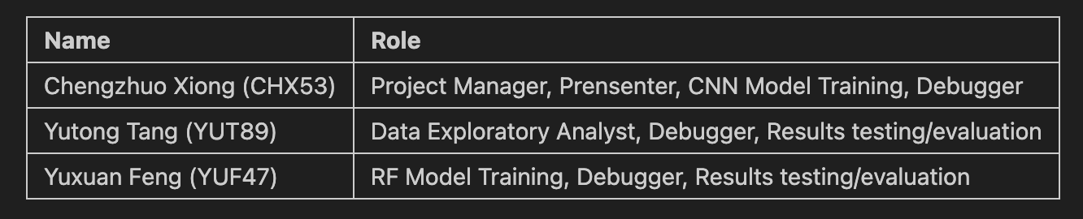
Team Members & Roles

Slide 4
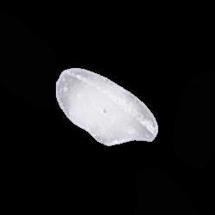

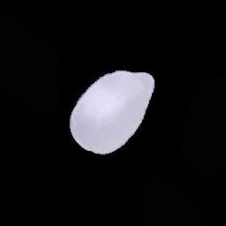
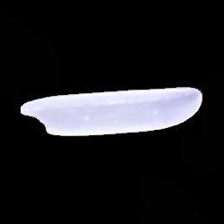

Problem
Arborio
Jasmine
Karacadage
Description:
Rice stands as one of the most extensively cultivated grains globally, showcasing a multitude of genetic variations. These variations are distinguished by characteristics such as texture, shape, and color. Utilizing these distinguishing traits allows for the classification and assessment of rice seed quality.
The rice image dataset from Kaggle comprises images of five distinct rice varieties: Arborio from Italy, Basmati from India, Ipsala and Karacadag from Turkey, and Jasmine from Thailand. Each variety is represented by 15,000 images.
Basmati
Ipsala

Slide 5
Solution & Resource & Use Scenario
The aim of our project is to develop a machine learning model capable of classifying rice varieties using image data. Utilizing the rice image dataset from Kaggle, we have implemented convolutional neural networks (CNNs, TensorFlow and Keras libraries in python) as well as Random Forests (scikit-learn library in python) to analyze the visual features that distinguish different types of rice grains. This endeavor not only contributes to agricultural research by providing insights into rice phenotypes but also aid in automating the quality control process within the food industry.
Koklu, M., Cinar, I., & Taspinar, Y. S. (2021). Classification of rice varieties with deep learning methods. Computers and Electronics in Agriculture, 187, 106285. https://doi.org/10.1016/j.compag.2021.106285
Cinar, I., & Koklu, M. (2021). Determination of Effective and Specific Physical Features of Rice Varieties by Computer Vision In Exterior Quality Inspection. Selcuk Journal of Agriculture and Food Sciences, 35(3), 229-243. https://doi.org/10.15316/SJAFS.2021.252
Cinar, I., & Koklu, M. (2022). Identification of Rice Varieties Using Machine Learning Algorithms. Journal of Agricultural Sciences https://doi.org/10.15832/ankutbd.862482
Cinar, I., & Koklu, M. (2019). Classification of Rice Varieties Using Artificial Intelligence Methods. International Journal of Intelligent Systems and Applications in Engineering, 7(3), 188-194. https://doi.org/10.18201/ijisae.2019355381

Slide 6
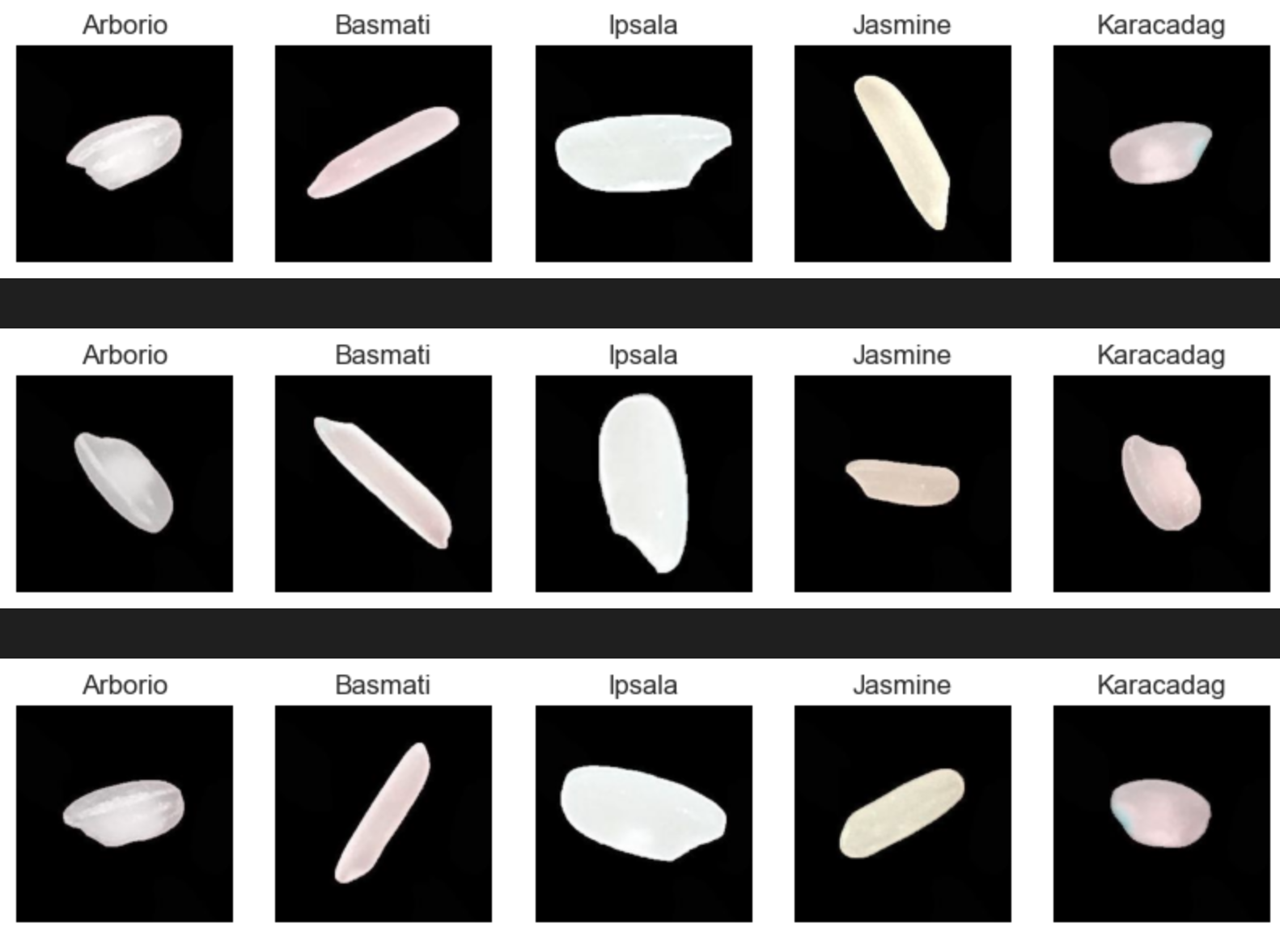
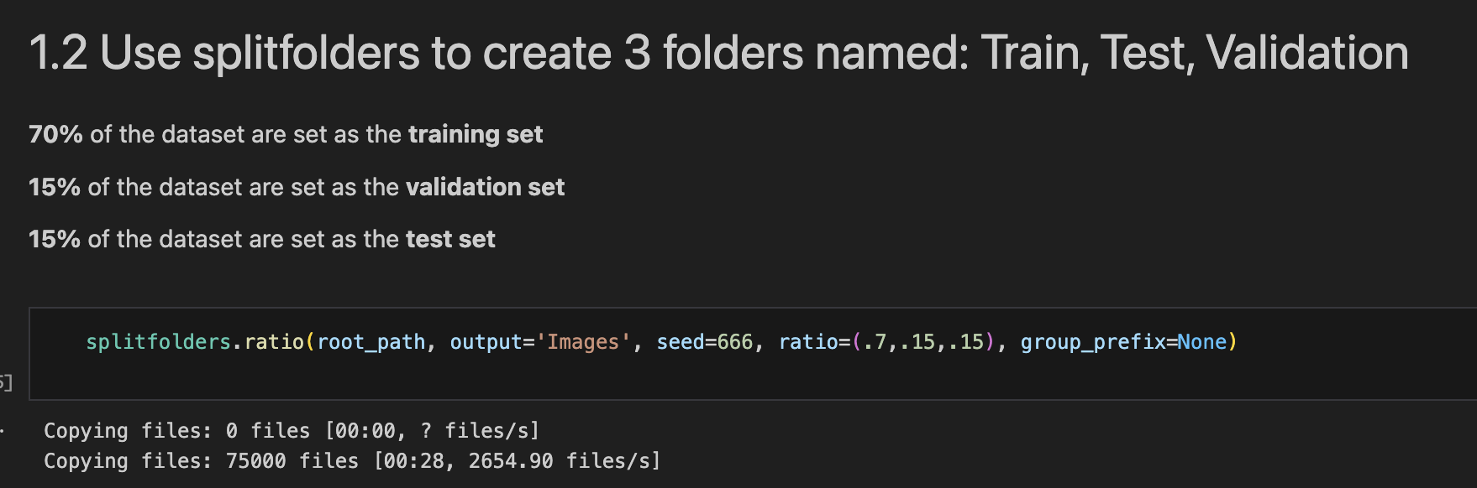
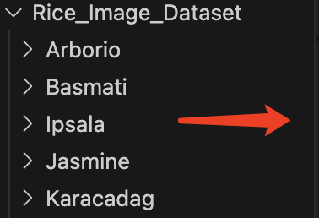
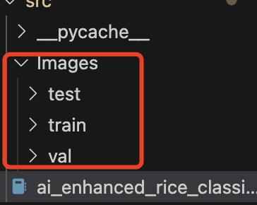
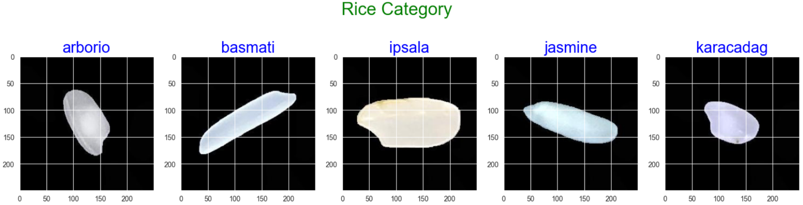
Detail of the implemented approaches
Data Pre-Process

Slide 7
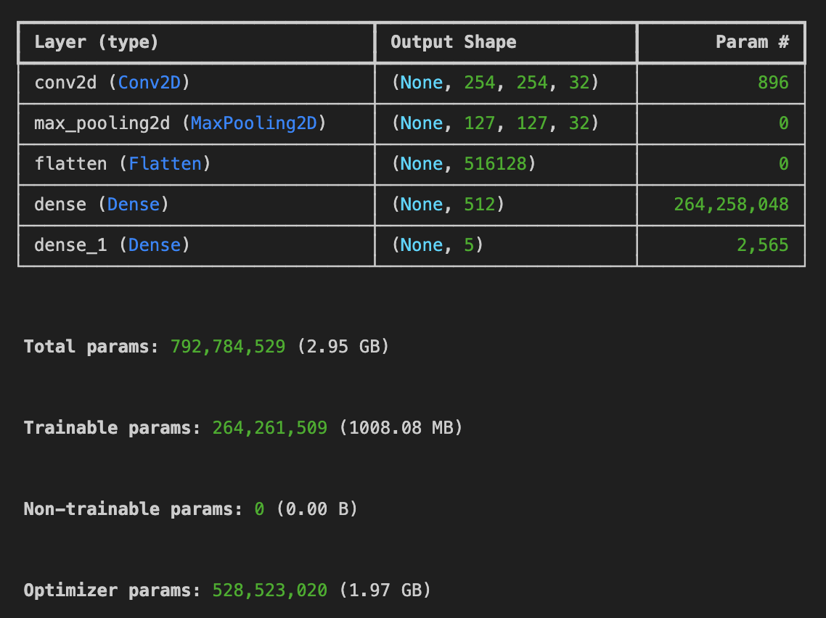

Detail of the implemented approaches
CNN Model
Model = CNN.fit(x=Train, validation_data=Val, epochs=3)
About 90 min training

Slide 8
Detail of the implemented approaches
Random Forest Model - The KEY point is to Extract features of the images
Convert to Grayscale:
Convert color images to grayscale to simplify processing and reduce computational requirements.
Image Thresholding:
Apply a binary threshold to the grayscale image, making pixels either black or white based on a threshold value to highlight significant features.
Find Contours:
Detect the outlines of objects in the thresholded image using contour detection techniques, which help identify and separate individual objects in the image.
Draw Contours:
Overlay detected contours onto the original image for visual verification of contour accuracy.
Calculate Image Features:
Extract features from the contours including:
Moments: Statistical properties of the shape such as skewness and eccentricity.
Area: The size of the area enclosed by the contour.
Centroid Coordinates: The central point of the contour, representing the object’s position.
Contour Length: The perimeter or length of the contour.
About 2 min training

Slide 9
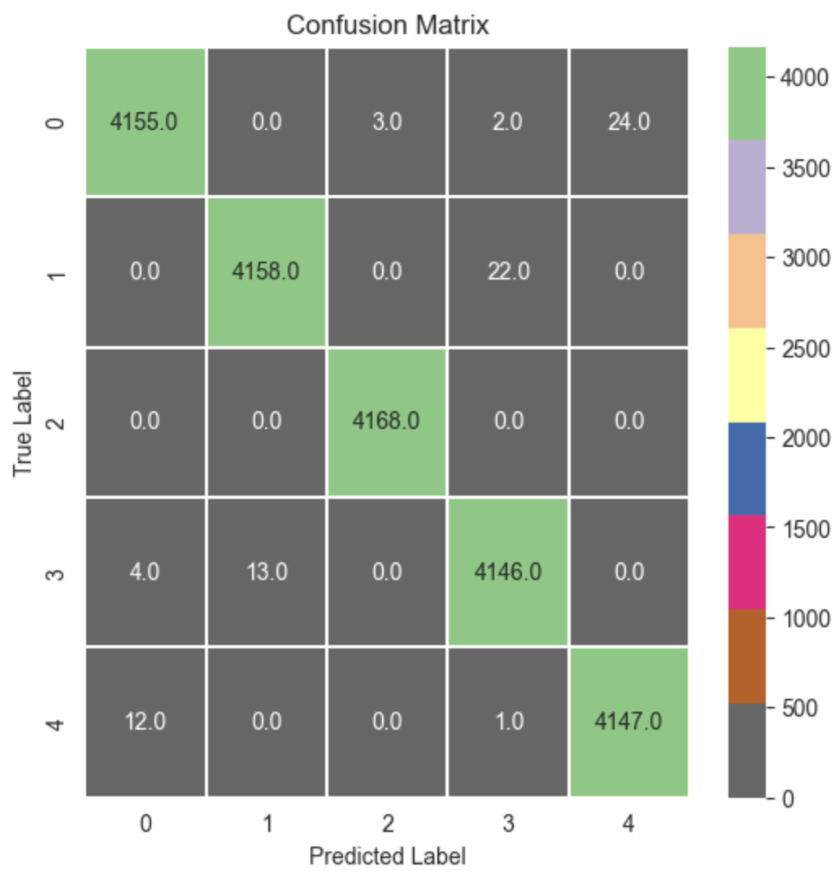
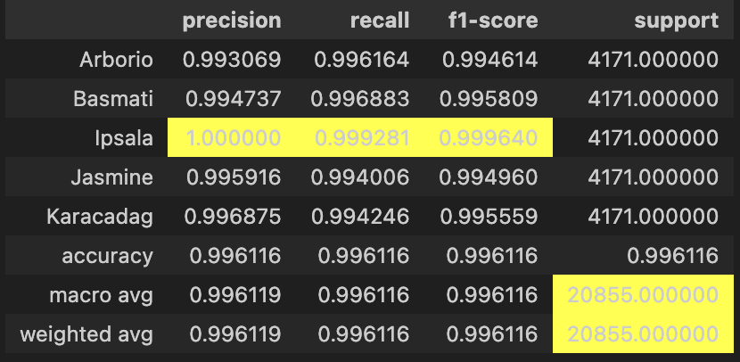
Evaluation Results
CNN Model - Key Score: accuracy = 0.996116

Slide 10
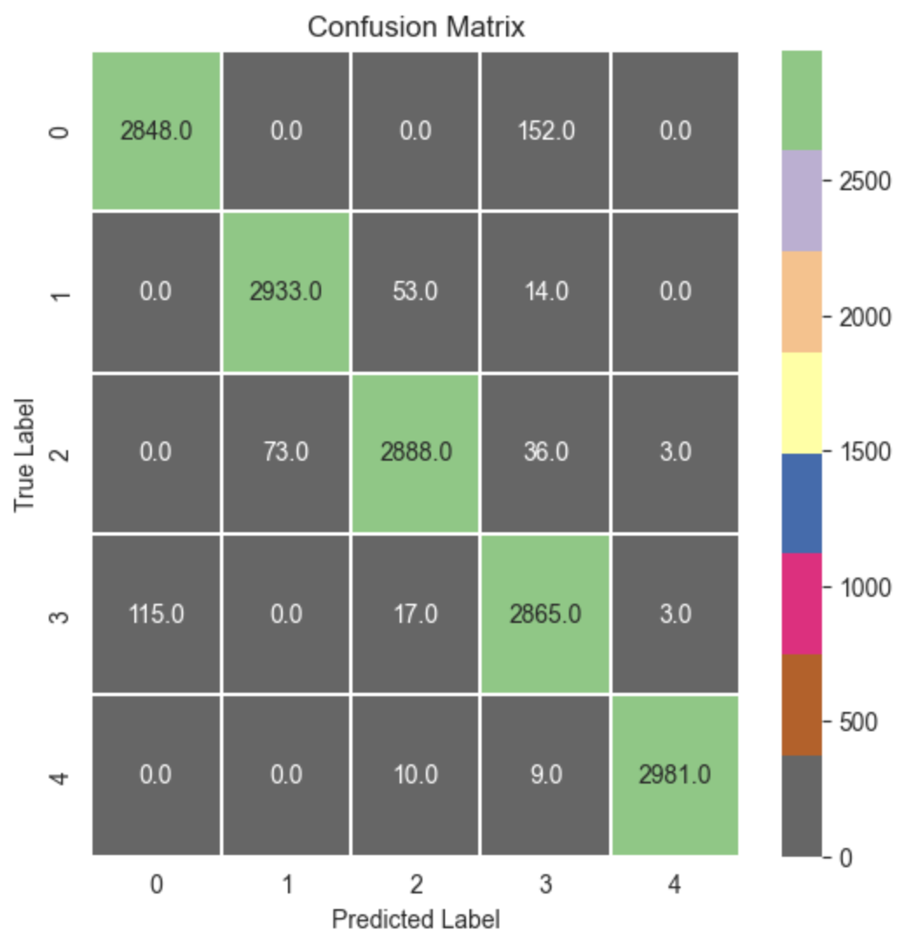
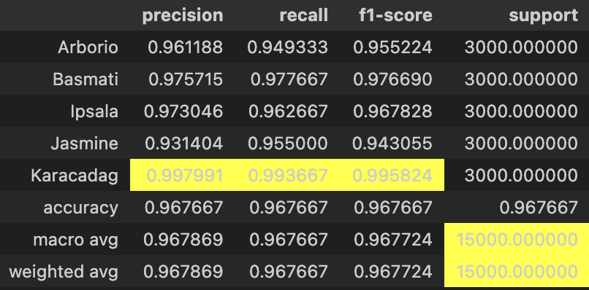
Evaluation Results
Random Forest Model - Key Score: accuracy = 0.967724 (less than CNN)

Slide 11
Conclusion & Model Selection
Accuracy:
CNN model is more accurate (99.61%) than the Random Forest model (96.77%).
Performance:
CNN has fewer misclassifications, higher precision, recall, and F1-scores across all classes.
Training Time:
CNN model takes significantly longer to train (90 minutes) compared to the Random Forest model (2 minutes).
Conclusion:
Despite longer training times, the CNN model is superior in performance for this image classification task. However, the Random Forest model is much faster to train and still provides relatively high accuracy, which might be preferable in scenarios where training time is a critical factor.

Slide 12
Part 2 Project Demo

